Slide 1
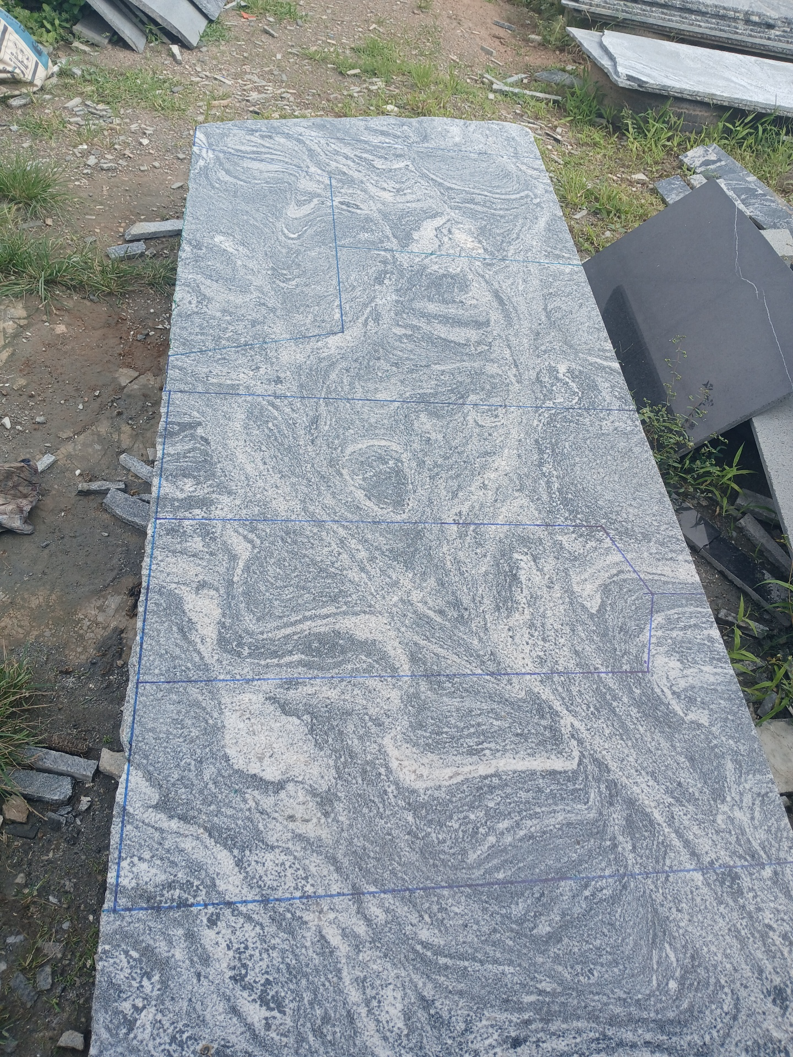
Abundance Marble
Jubiano:[ slap price #40000
]
<*8f/2iin*
*4/21in>
cm:[ 2.44×0.65=1.586
1.22×0.65=0.793
=2.379]
( 2.379×40,000
=95,160)
95,160×8=761,280. Total::761,500.

